Slide 1
Magnetism
EP0605
Pre-class (1 to 14)
in-class (16 onwardS)

Slide 2
Learning objectives
Define a magnetic field.
State the formula for magnetic forces on moving charges using vector notations and perform calculations on it.

Slide 3
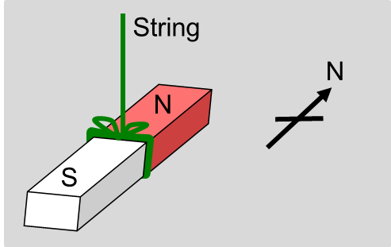
Magnetism
Magnetic phenomena were first observed more than 2500 years ago in Turkey.
If a bar magnet is free to rotate about a vertical axis, one end of the magnet points towards the magnetic north and is called the north seeking pole (N).
The other end point of the magnet points towards the magnetic south and is called the south seeking pole (S).

Slide 4
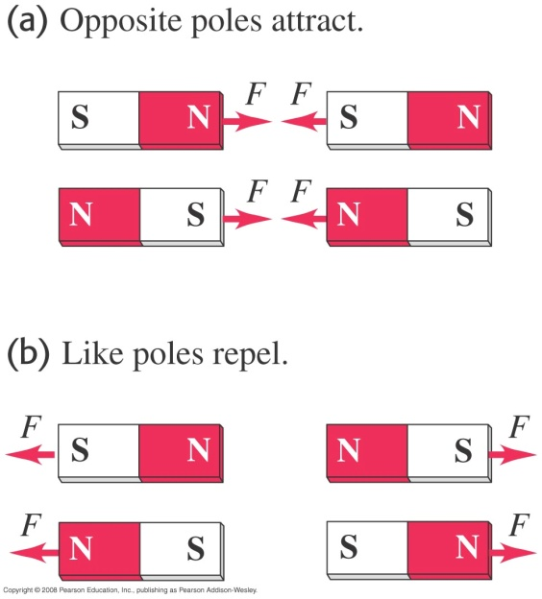
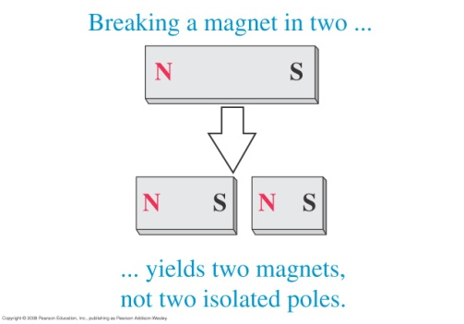
Properties of magnetic poles
Like poles repel and unlike poles attract.
If a bar magnet is broken into two parts, each part will have a N pole and a S pole.
In other words, a magnetic monopole (N or S) does not exist!

Slide 5
Magnetic field
A magnetic field is a region where a magnetic pole or a moving electric charge experiences a magnetic force.
A stationary magnetic pole can experience a magnetic force but an electric charge must move in order for it to experience a magnetic force.
This is because a moving charge is equivalent to an electric current (I = Q/t) and an electric current produces a magnetic field around it.
We will first investigate the magnetic force on a single moving charge followed by the magnetic force on a current carrying conductor, i.e. a continuous stream of moving charges.

Slide 6
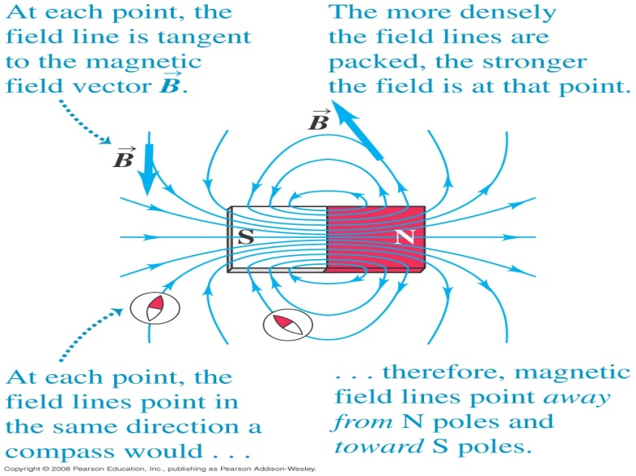
Representing a magnetic field
A magnetic field is represented by magnetic lines of force or simply magnetic field lines.
The field lines starts from the N pole and ends at S pole.
The denser the field lines, the stronger the magnetic field.
The direction of the magnetic field at any point is tangent to the field line.

Slide 7
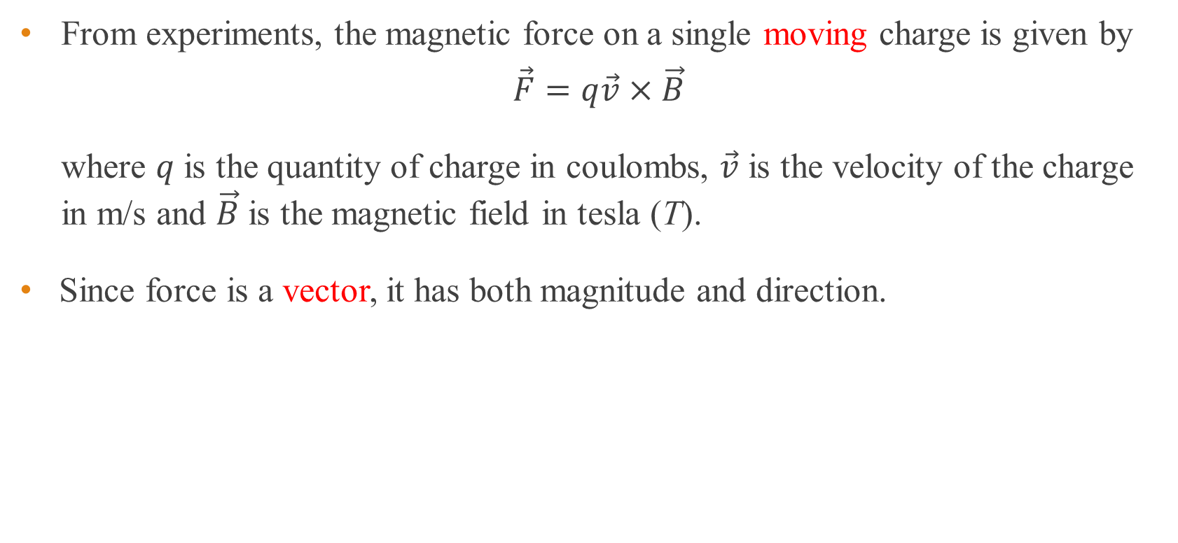
Magnetic force on single moving charge
From experiments, the magnetic force on a single moving charge is given by
$$\vec{F}=q\vec{v}×\vec{B}$$
where $q$ is the quantity of charge in coulombs, $\vec{v}$ is the velocity of the charge in m/s and $\vec{B}$ is the magnetic field in tesla (T).
Since force is a vector, it has both magnitude and direction.

Slide 8
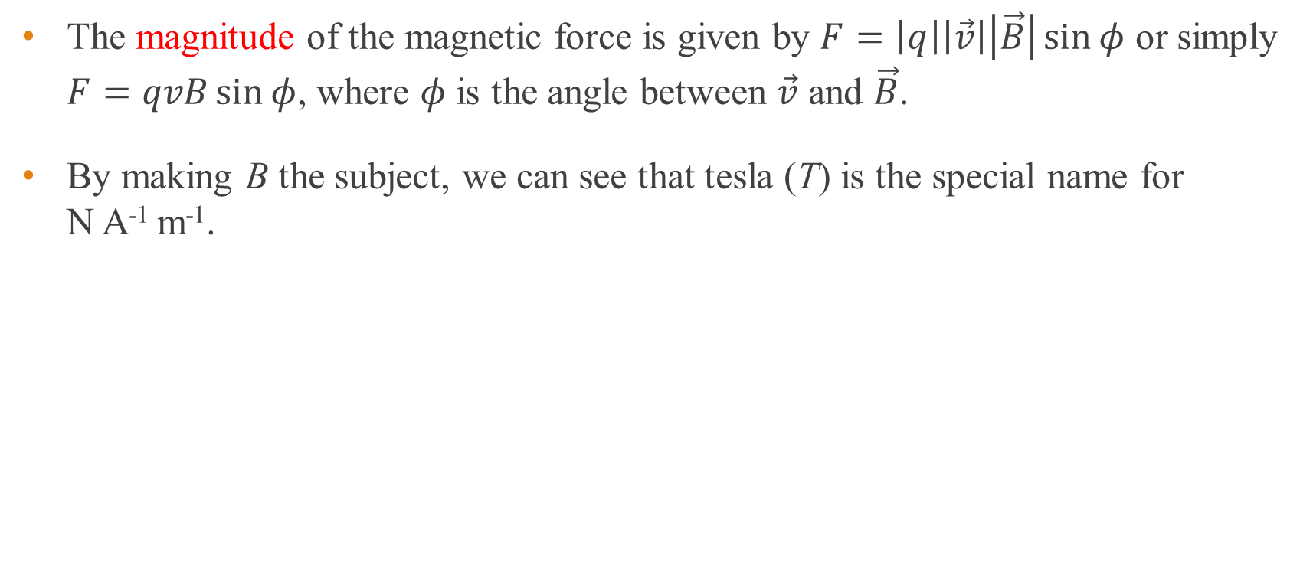
Magnitude of magnetic force on moving charge
The magnitude of the magnetic force is given by $F=\left|q\right|\left|\vec{v}\right|\left|\vec{B}\right|\sin{φ}$ or simply $F=qvB\sin{φ}$, where $φ$ is the angle between $\vec{v}$ and $\vec{B}$.
By making B the subject, we can see that tesla (T) is the special name for N A⁻¹ m⁻¹.

Slide 9



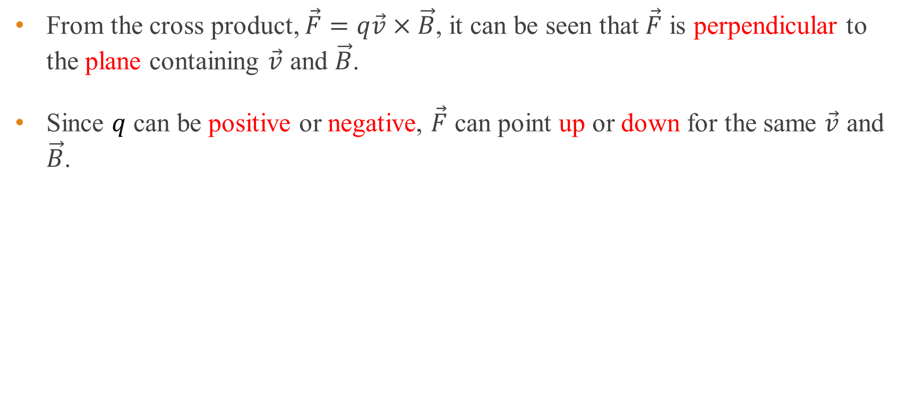





Direction of magnetic force on moving charge
From the cross product, $\vec{F}=q\vec{v}×\vec{B}$, it can be seen that $\vec{F}$ is perpendicular to the plane containing $\vec{v}$ and $\vec{B}$.
Since $q$ can be positive or negative, $\vec{F}$ can point up or down for the same $\vec{v}$ and $\vec{B}$.
Positive $q$
Negative $q$
$$\vec{B}$$
$$\vec{B}$$
$$\vec{F}$$
ϕ
ϕ
y
y
$$\vec{v}$$
$$\vec{v}$$
x
x
$$−\vec{F}$$

Slide 10
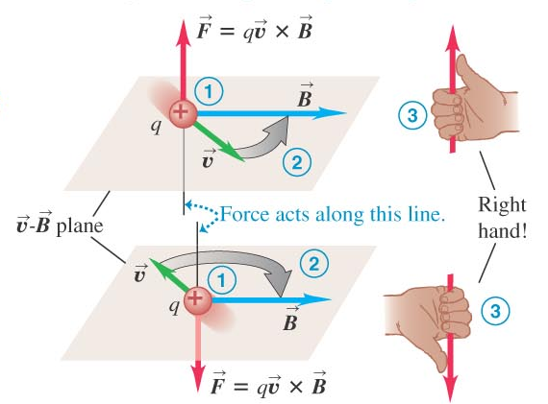
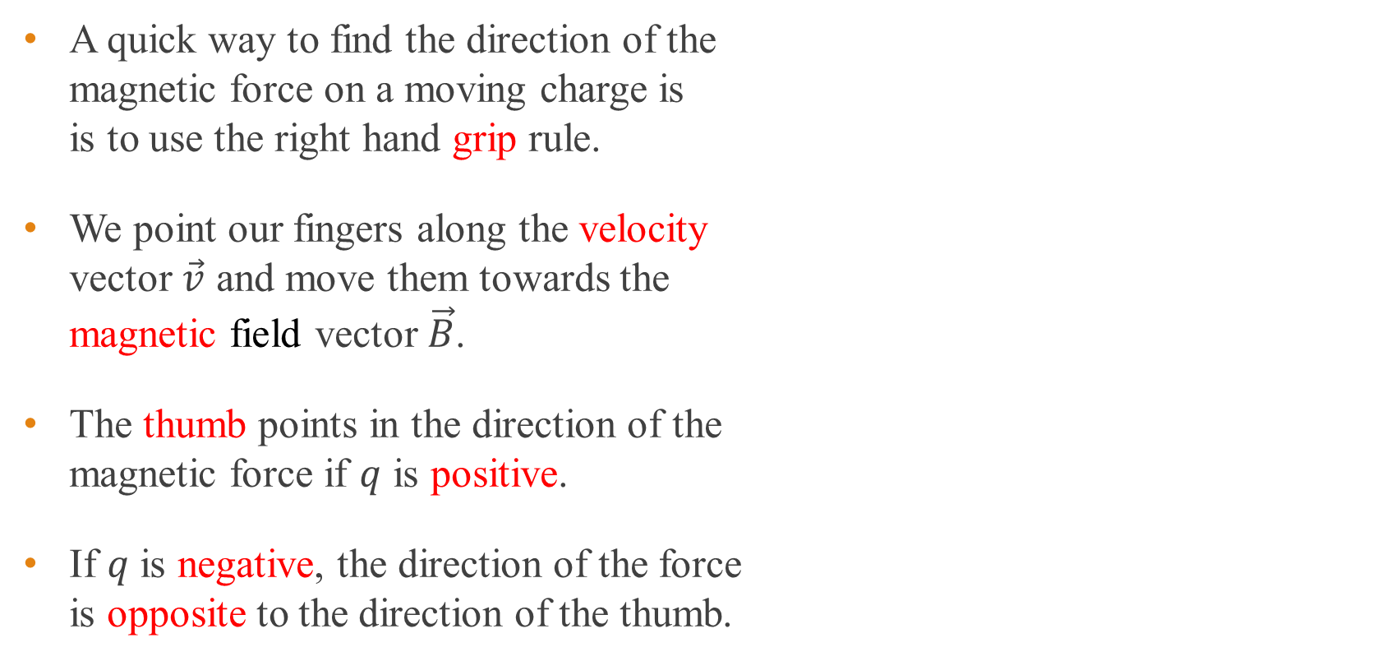
Right-hand grip rule for direction of magnetic force
A quick way to find the direction of the magnetic force on a moving charge is is to use the right hand grip rule.
We point our fingers along the velocity vector $\vec{v}$ and move them towards the magnetic field vector $\vec{B}$.
The thumb points in the direction of the magnetic force if $q$ is positive.
If $q$ is negative, the direction of the force is opposite to the direction of the thumb.

Slide 11
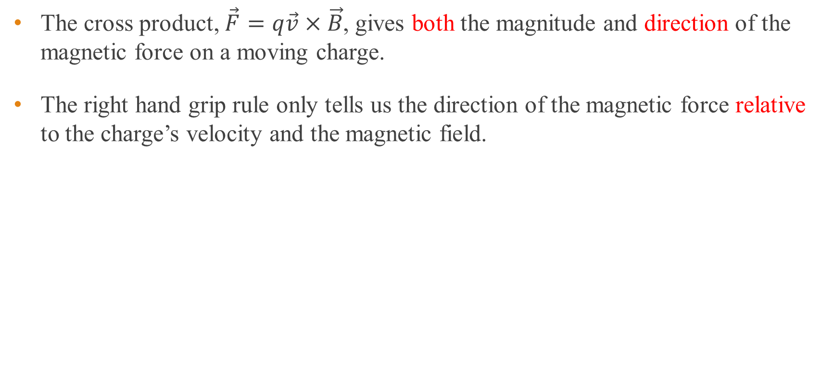
Right-hand grip rule for direction of magnetic force
The cross product, $\vec{F}=q\vec{v}×\vec{B}$, gives both the magnitude and direction of the magnetic force on a moving charge.
The right hand grip rule only tells us the direction of the magnetic force relative to the charge’s velocity and the magnetic field.

Slide 12




Example 1
A proton moves along the positive y-axis at 1.0 × 10⁵ m/s through a uniform magnetic field of magnitude 1.2 T directed along the negative x-axis as shown. What is the direction and magnitude of the magnetic force on the proton? Charge of a proton is 1.6 × 10⁻¹⁹ C.
Solution:
Using the vector cross product,
$\vec{v}=1.0×{10}^{5} \hat{j}$ m/s, $\vec{B}=−1.2 \hat{i}$ T
$$\vec{F}=q\vec{v}×\vec{B}=1.6×{10}^{−19}\left|\begin{matrix}\hat{i} & \hat{j} & \hat{k} \\ 0 & 1.0×{10}^{5} & 0 \\ −1.2 & 0 & 0\end{matrix}\right|$$
$\vec{F}=1.92×{10}^{−14} \hat{k}$ N $=1.9×{10}^{−14} \hat{k}$ N (2 s.f.)
$$\vec{F}$$
$$\vec{B}$$
90°
y
$$\vec{v}$$
x

Slide 13




Example 2
An electron moves along the positive y- axis at 1.0 × 10⁵ m/s through a uniform magnetic field of magnitude 1.2 T directed along the negative x-axis as shown. What is the direction and magnitude of the magnetic force on the electron? Charge of an electron is –1.6 × 10⁻¹⁹ C.
Solution:
Using the vector cross product,
$\vec{v}=1.0×{10}^{5} \hat{j}$ m/s, $\vec{B}=−1.2 \hat{i}$ T
$$\vec{F}=q\vec{v}×\vec{B}=−1.6×{10}^{−19}\left|\begin{matrix}\hat{i} & \hat{j} & \hat{k} \\ 0 & 1.0×{10}^{5} & 0 \\ −1.2 & 0 & 0\end{matrix}\right|$$
$\vec{F}=−1.92×{10}^{−14} \hat{k}$ N $=−1.9×{10}^{−14} \hat{k}$ N (2 s.f.)
$$\vec{B}$$
90º
y
$$\vec{v}$$
x
$$\vec{F}$$

Slide 14
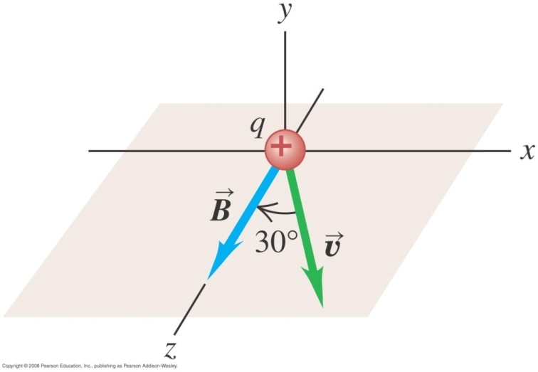

Example 3
A beam of protons moves at 3.0 × 10⁵ m/s through a uniform magnetic field with a magnitude 2.0 T. The magnetic field is directed along the positive z-axis as shown in the below figure. The velocity of each proton lies in the x-z plane at an angle of 30° to the positive z-axis. Find the force on a proton. Charge of a proton is 1.6 × 10⁻¹⁹ C.
Solution:
Using the vector cross product,
$\vec{v}=3.0×{10}^{5}\left(\sin{30°}\hat{i}+\cos{30°}\hat{k}\right)$ m/s, $\vec{B}=2.0 \hat{k}$ T
$$\vec{F}=q\vec{v}×\vec{B}=1.6×{10}^{−19}\left|\begin{matrix}\hat{i} & \hat{j} & \hat{k} \\ 3\sin{30°} & 0 & 3\cos{30°} \\ 0 & 0 & 2.0\end{matrix}\right|×{10}^{5}$$
$\vec{F}=−4.8×{10}^{−14} \hat{j}$ N

Slide 15
End of pre-class slides

Slide 16
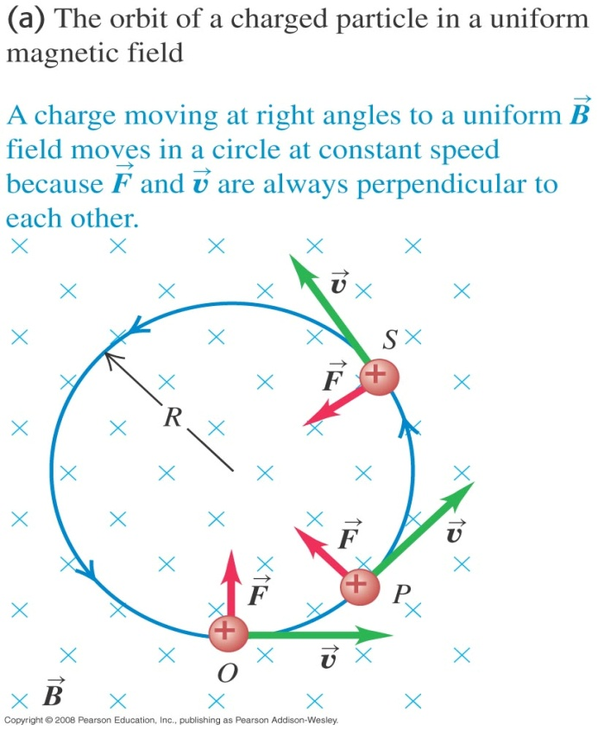
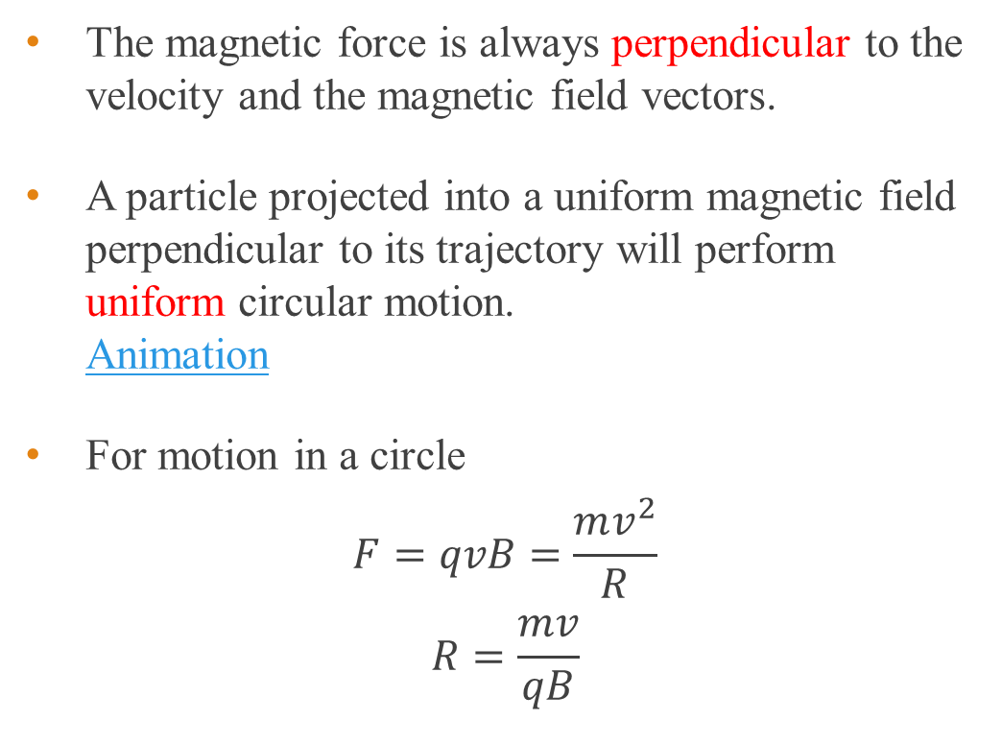
Charge moving perpendicular to uniform B field
The magnetic force is always perpendicular to the velocity and the magnetic field vectors.
A particle projected into a uniform magnetic field perpendicular to its trajectory will perform uniform circular motion. Animation
For motion in a circle
$$F=qvB=\frac{mv^{2}}{R}$$
$$R=\frac{mv}{qB}$$

Slide 17
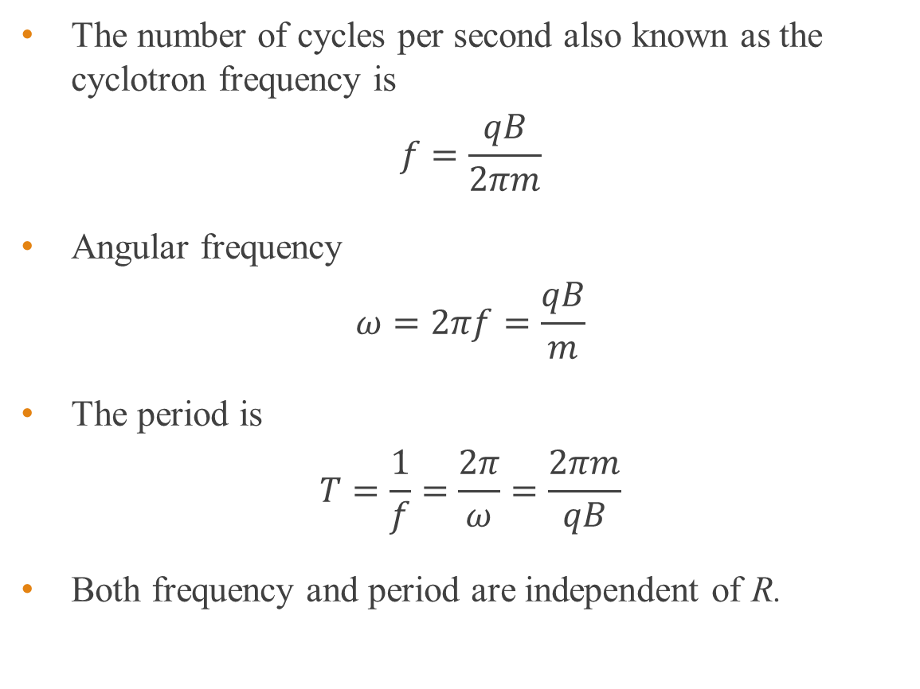
Cyclotron frequency
The number of cycles per second also known as the cyclotron frequency is
$$f=\frac{qB}{2πm}$$
Angular frequency
$$ω=2πf=\frac{qB}{m}$$
The period is
$$T=\frac{1}{f}=\frac{2π}{ω}=\frac{2πm}{qB}$$
Both frequency and period are independent of R.

Slide 18

Example 4
A proton moving at 1.00 × 10⁵ m/s along y-axis enters a uniform magnetic field with a magnitude 2.00 T. If the field points into the page (+x), determine the centripetal force on the proton and its period of rotation. Charge of a proton is 1.60 × 10⁻¹⁹ C. Mass of proton is 1.67 × 10⁻²⁷ kg.
Using the right hand grip rule, the initial force on the proton is in the positive z-axis.
Solution:
The magnitude of the force is $F=qvB$.
$$F=\left(1.6×{10}^{−19}\right)\left(1.0×{10}^{5}\right)\left(2.0\right)$$
$F=3.2×{10}^{−14}$ N
$$f=\frac{qB}{2πm}=\frac{1.6×{10}^{−19}\left(2.0\right)}{2π\left(1.7×{10}^{−27}\right)}=3.0×{10}^{7} Hz$$
$$T=\frac{1}{f}=3.3×{10}^{−8} \text{s}$$
Circular path in y-z plane
y
x

Slide 19
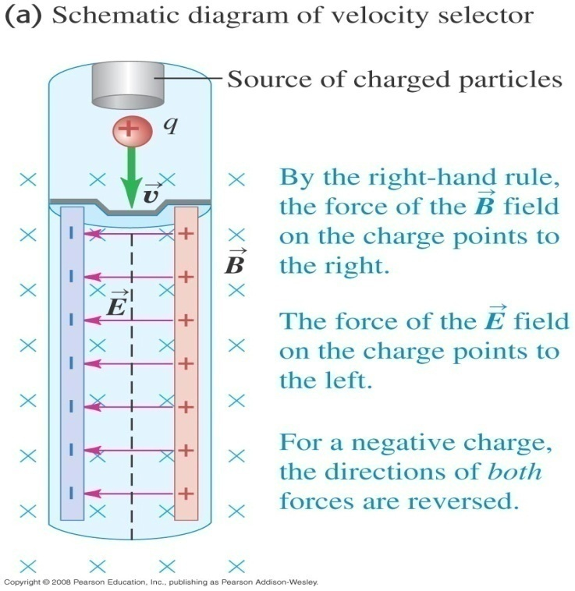
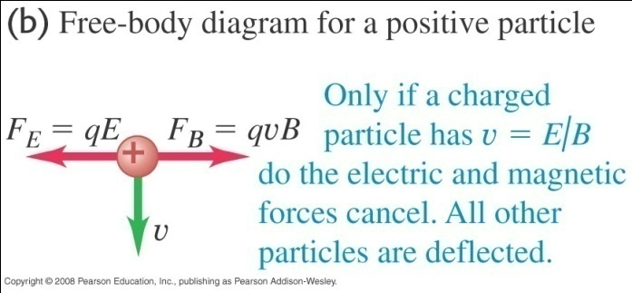
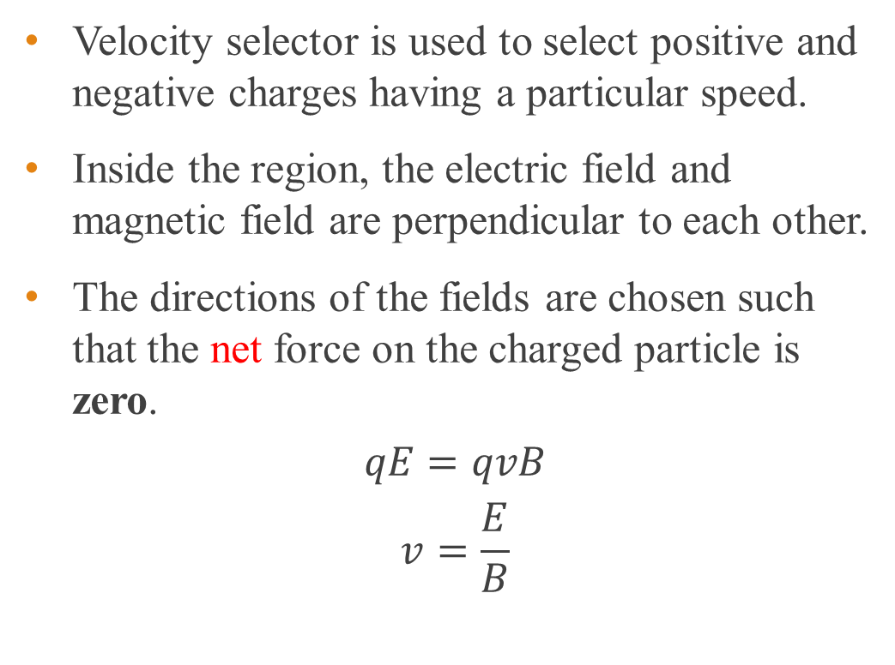
Velocity selector
Velocity selector is used to select positive and negative charges having a particular speed.
Inside the region, the electric field and magnetic field are perpendicular to each other.
The directions of the fields are chosen such that the net force on the charged particle is zero.
$$qE=qvB$$
$$v=\frac{E}{B}$$

Slide 20
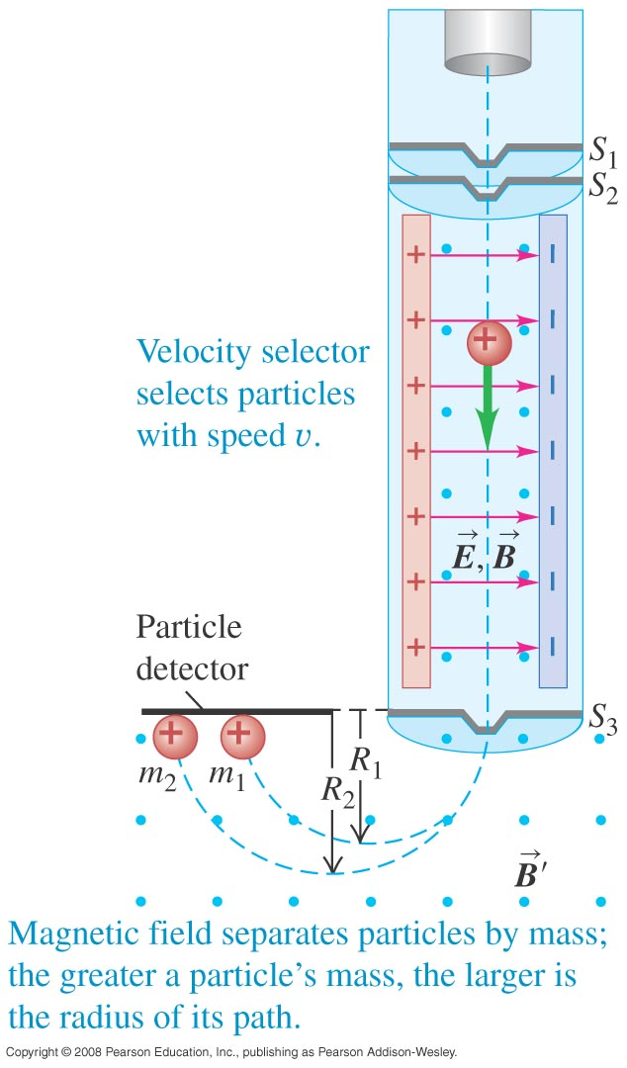
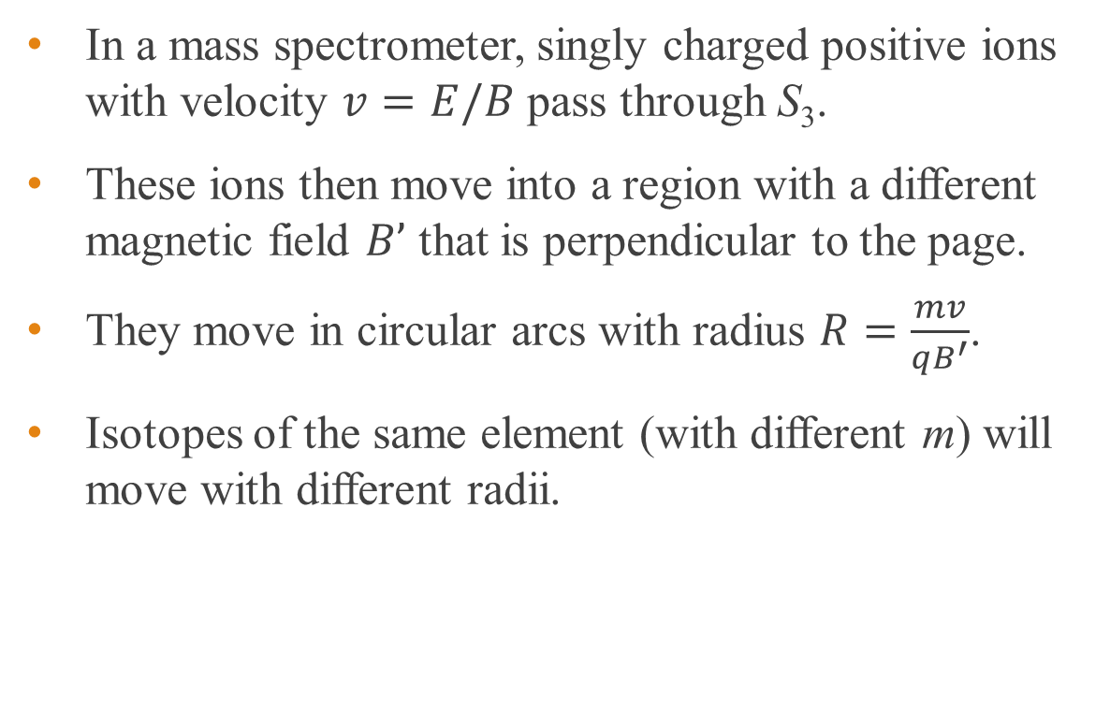
Mass spectrometer
In a mass spectrometer, singly charged positive ions with velocity $v=E/B$ pass through S₃.
These ions then move into a region with a different magnetic field $B’$ that is perpendicular to the page.
They move in circular arcs with radius $R=\frac{mv}{qB^{′}}$.
Isotopes of the same element (with different m) will move with different radii.

Slide 21
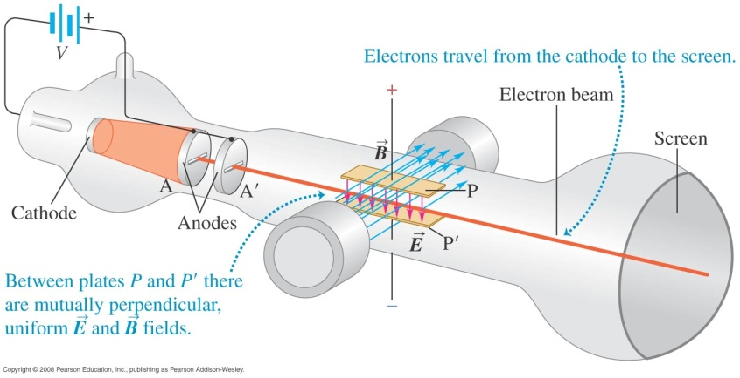
Thomson’s e/m experiment
Electrons in a glass container are accelerated by a p.d. V between anodes A and A’ and enter a magnetic field.
The work done by the electric field on the electrons is eV, where e is the electronic charge. The electrons gain kinetic energy.

Slide 22
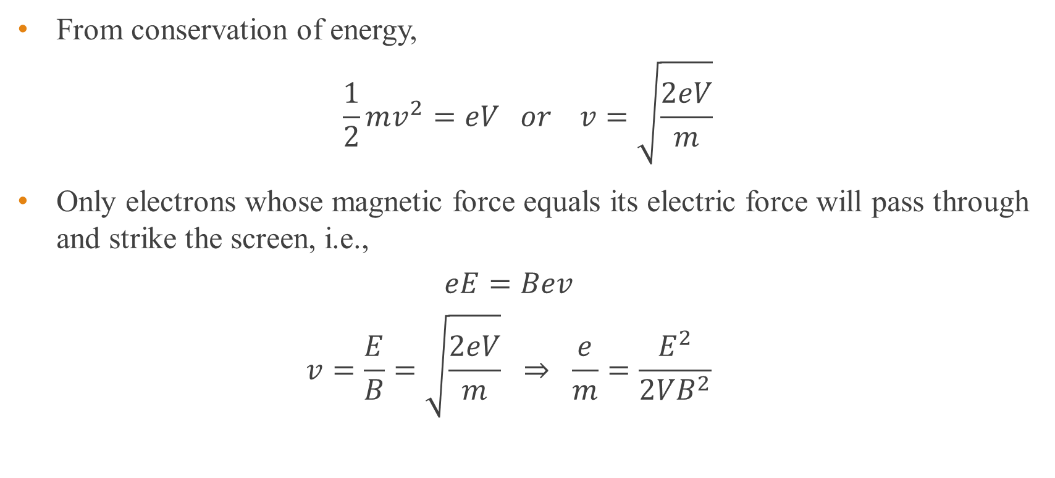
Thomson’s e/m experiment - cont
From conservation of energy,
$$\frac{1}{2}mv^{2}=eV or v=\sqrt{\frac{2eV}{m}}$$
Only electrons whose magnetic force equals its electric force will pass through and strike the screen, i.e.,
$$eE=Bev$$
$$v=\frac{E}{B}=\sqrt{\frac{2eV}{m}} ⇒ \frac{e}{m}=\frac{E^{2}}{2VB^{2}}$$

Slide 23
Thomson’s e/m experiment - cont
There is only a single value of e/m = 1.76 x 10¹¹ C kg⁻¹.
Since this value did not depend on the cathode material, the electrons in the beam is a common constituent of all matters.
After some years Millikan succeeded in measuring the charge of the electron.
Combining with Thomson’s result and Millikan’s experiments, the mass of the electron was determined to be about 9.11 x 10⁻³¹ kg.

Slide 24
Example 5
In a Thomson’s e/m experiment, the accelerating potential is 150 V with a deflecting electric field of magnitude 6.0 × 10⁶ N/C. Speed of light is 3 × 10⁸ m/s. Mass of the electron = 9.11 × 10⁻³¹ kg.
a) At what fraction of the speed of light do the electrons move?
b) What should be the magnetic field?
c) With this magnetic field, what will happen to the electron beam if the accelerating potential is increased above 150 V?
Notes:
0.024 times the speed of light
B = 0.83 T
c) Increasing potential V will increase the speed. The upward electric force does not change but the magnetic force will increase and the electron beam will turn downward and will hit the hit the tube below the undeflected position.

Slide 25
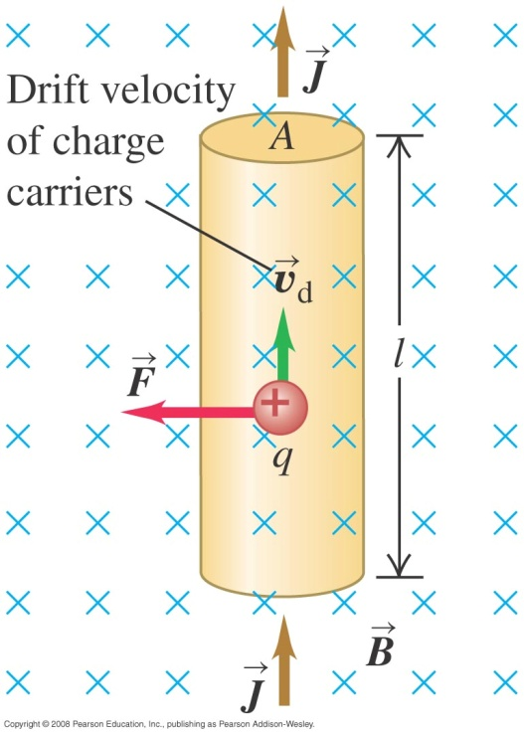
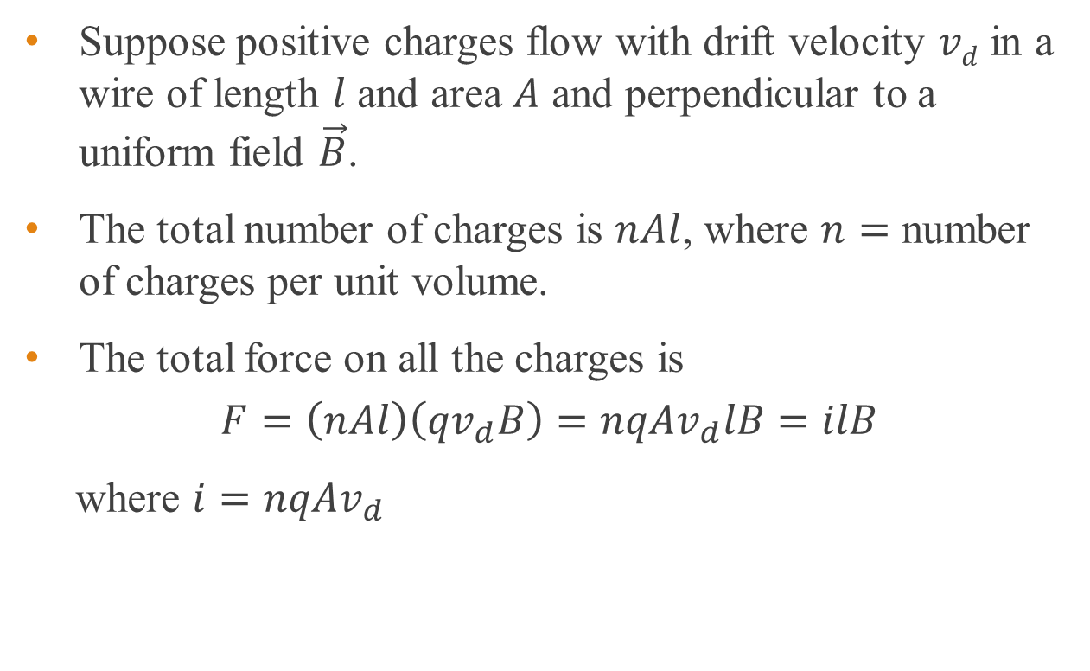
Magnetic force on a current-carrying conductor
Suppose positive charges flow with drift velocity $vd$ in a wire of length $l$ and area $A$ and perpendicular to a uniform field $\vec{B}$.
The total number of charges is $nAl$, where $n=$ number of charges per unit volume.
The total force on all the charges is
$$F=\left(nAl\right)\left(qv_{d}B\right)=nqAv_{d}lB=ilB$$
where $i=nqAv_{d}$

Slide 26
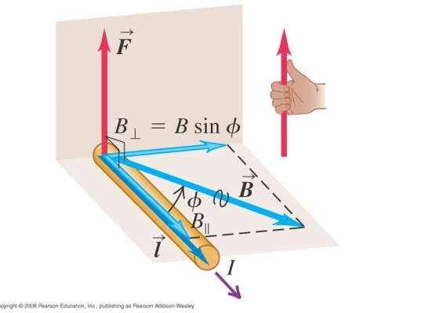
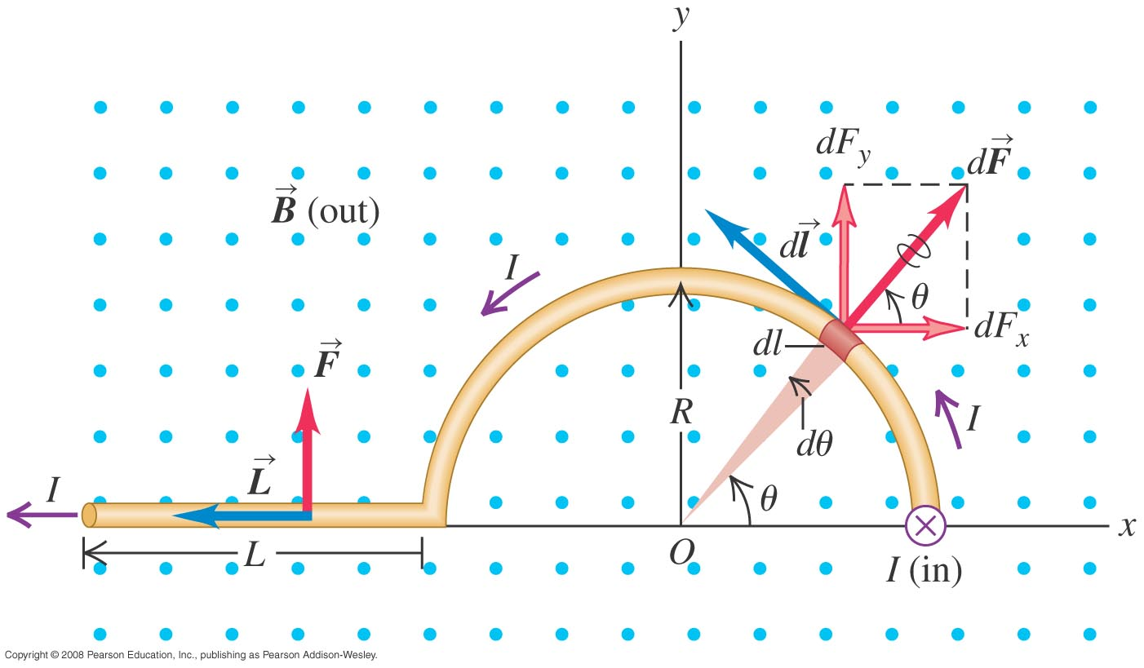
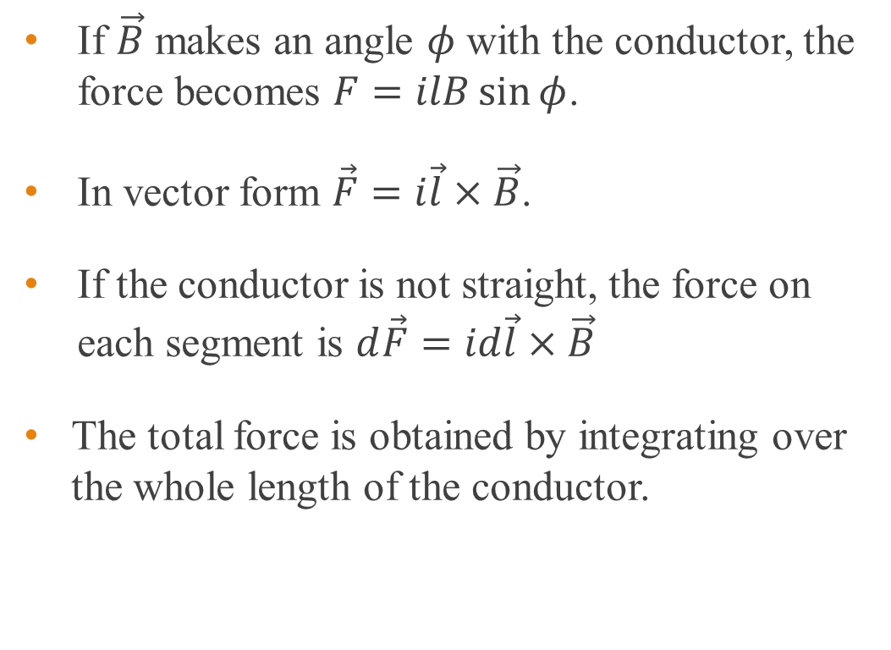
Magnetic force on a current-carrying conductor
If $\vec{B}$ makes an angle $φ$ with the conductor, the force becomes $F=ilB\sin{φ}$.
In vector form $\vec{F}=i\vec{l}×\vec{B}$.
If the conductor is not straight, the force on each segment is $d\vec{F}=id\vec{l}×\vec{B}$
The total force is obtained by integrating over the whole length of the conductor.

Slide 27
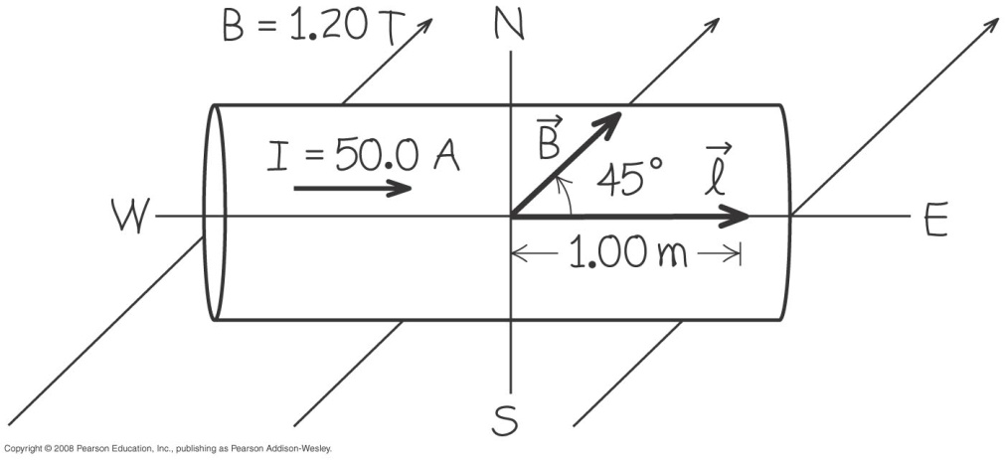
Example 6
A straight horizontal copper rod carries a current of 50.0 A from west to east in a region between the poles of a large electromagnet. In this region there is a horizontal magnetic field toward the north east (45° north of east) with magnitude 1.20 T.
a) Find the magnitude and direction of the force on a 1.00-m section of rod.
b) What should be done to the rod to maximize the magnitude of force?
c) What is the magnitude of the force in the above case in b)?
Notes:
F = 42.4 N in the +z direction (upward). F = (42.4 N) k
The angle between the l and B should be 90º. Rotate the rod clockwise by 45º from its orientation so that the current runs toward the south east.
c) F = 60.0 N

Slide 28
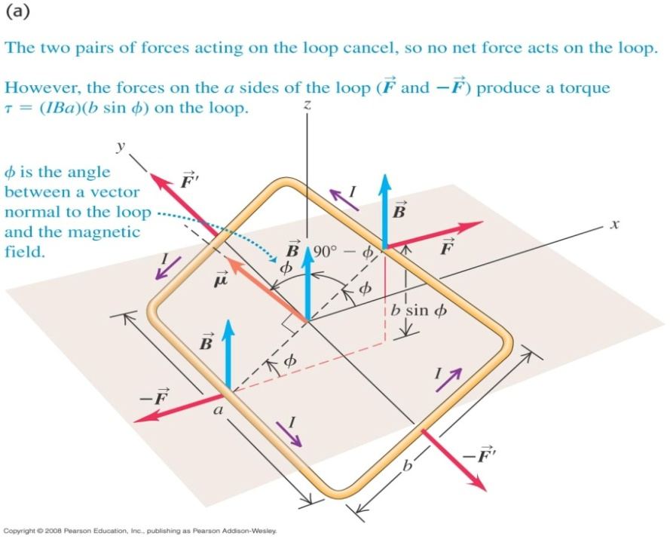
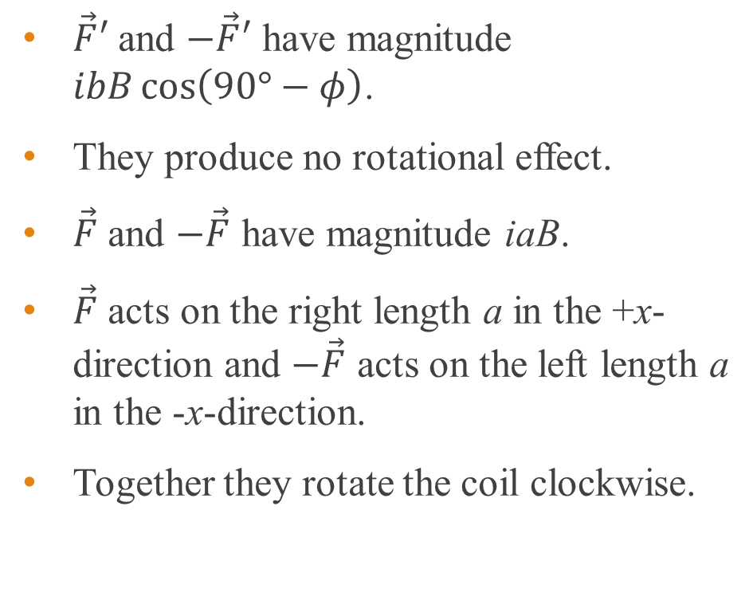
Rotation of a current loop in a magnetic field
$\vec{F}′$ and $−\vec{F}′$ have magnitude $ibB\cos\left(90°−φ\right)$.
They produce no rotational effect.
$\vec{F}$ and $−\vec{F}$ have magnitude iaB.
$\vec{F}$ acts on the right length a in the +x-direction and $−\vec{F}$ acts on the left length a in the -x-direction.
Together they rotate the coil clockwise.

Slide 29
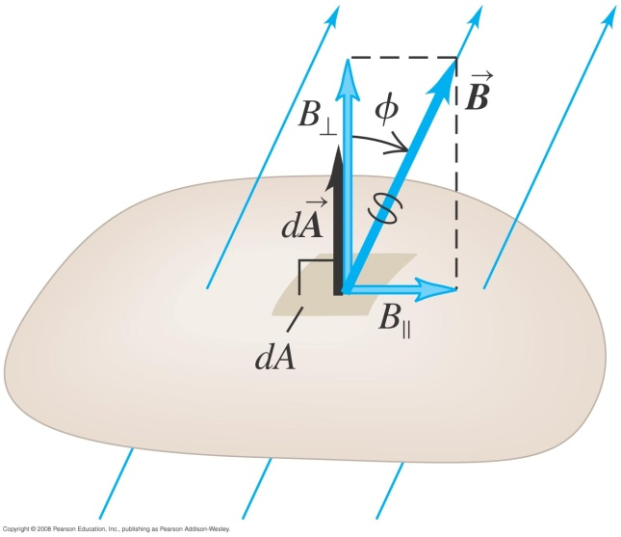
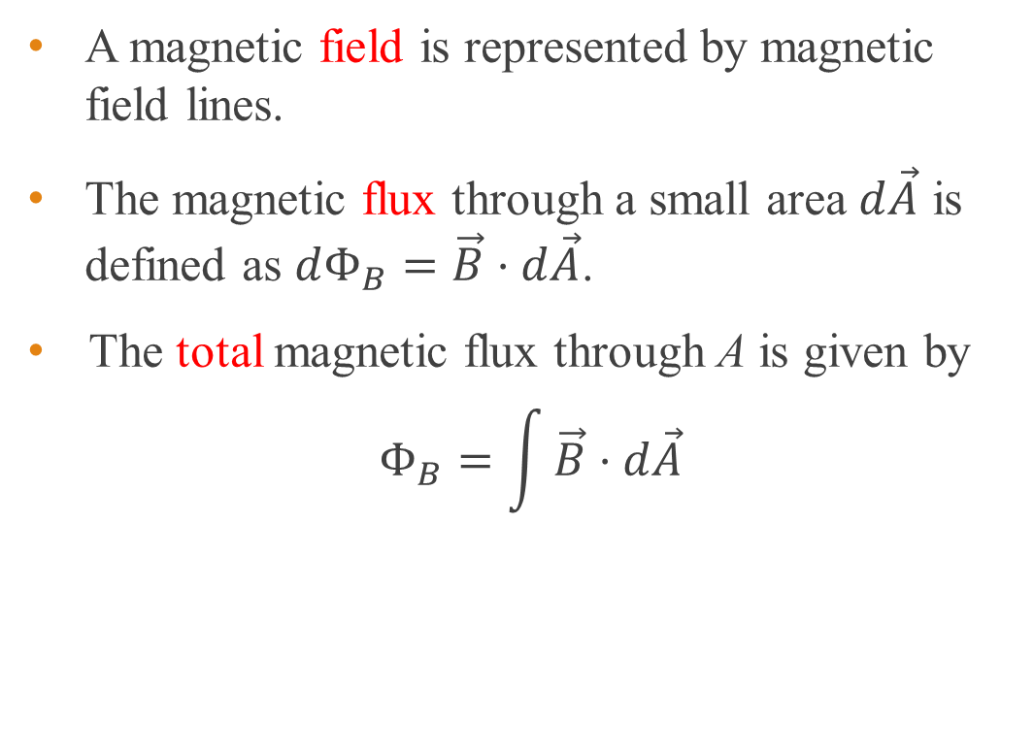
Magnetic flux
A magnetic field is represented by magnetic field lines.
The magnetic flux through a small area $d\vec{A}$ is defined as $dΦ_{B}=\vec{B}⋅d\vec{A}$.
The total magnetic flux through A is given by
$$Φ_{B}=\int{\vec{B}⋅d\vec{A}}$$

Slide 30

Magnetic flux
If B is in tesla (T) and A is in m², the SI unit of $Φ_{B}$ is T m².
Hence the SI unit of magnetic flux is T m² or weber (Wb).

Slide 31

Example 7
The figure below shows a perspective view of a flat surface with area 1.0 cm² in a uniform magnetic field of 2.0 T. (a) What is the magnetic flux through the area? (b) What is the magnetic flux if A is rotated so that it is perpendicular to B?
Solution:
(a) Since B is uniform throughout the area and A is a flat surface,
$$Φ_{B}=\int{\vec{B}⋅d\vec{A}}=\vec{B}⋅\int{d\vec{A}}$$
$$Φ_{B}=\vec{B}⋅\vec{A}=BA\cos{θ}$$
$Φ_{B}=2.0×1.0×{10}^{−4}\cos{30°}=1.7×{10}^{−4}$ Wb
(b) Since $\cos{90°}=0$, the flux is zero.
30º

Slide 32
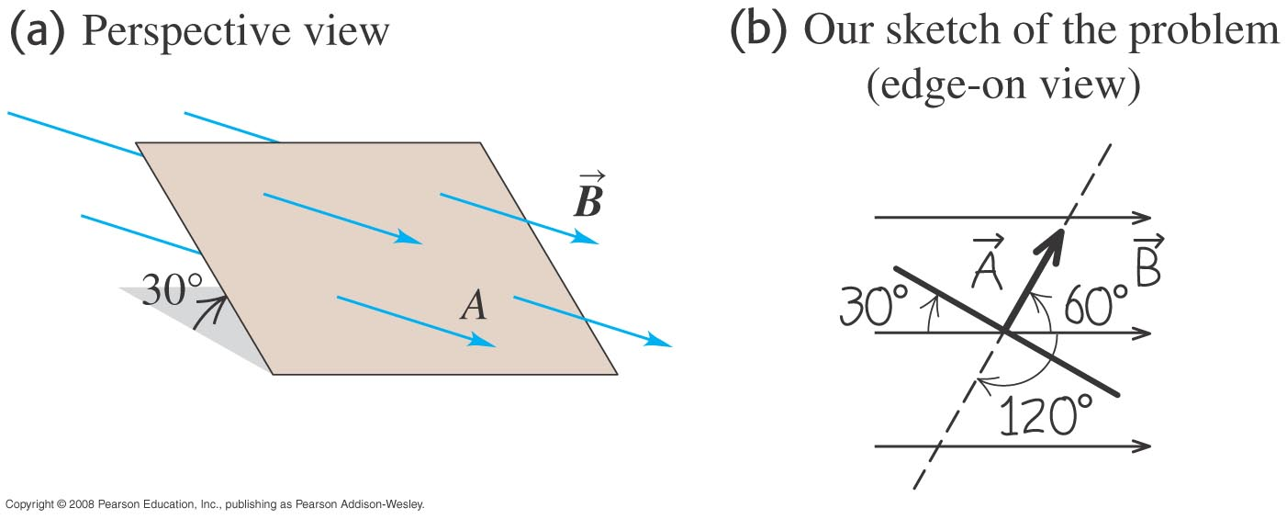

Example 8
The below figure shows a perspective view of a flat surface with area 3.0 cm² in a uniform magnetic field. If the magnetic flux through this area is 0.90 mWb, calculate the magnetic field and find the direction of the area vector.
Solution:
Since the direction of $\vec{A}$ is in the direction of the normal to the surface, the angle between $\vec{B}$ and $\vec{A}$ is $60°$.
$$Φ_{B}=BA\cos{60°}$$
$$0.90×{10}^{−3}=B\left(3.0×{10}^{−4}\right)\cos{60°}$$
$$B=6.0 \text{T}$$
Notes:
B = 6.0 T and Area is 60º to the magnetic field.

Slide 33
Optional slides

Slide 34
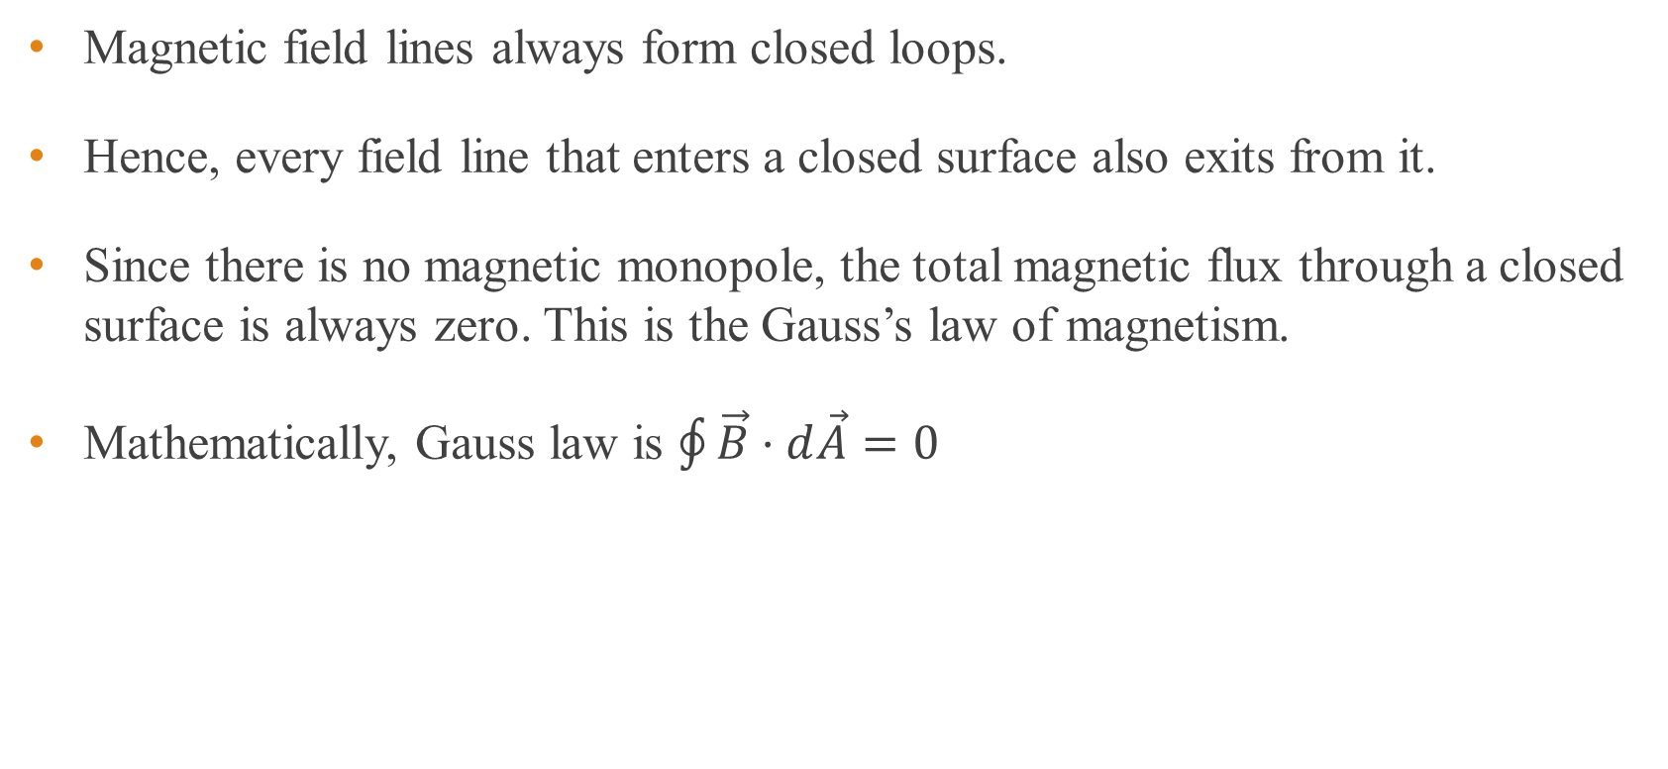
Gauss law of magnetism
Magnetic field lines always form closed loops.
Hence, every field line that enters a closed surface also exits from it.
Since there is no magnetic monopole, the total magnetic flux through a closed surface is always zero. This is the Gauss’s law of magnetism.
Mathematically, Gauss law is $\oint{\vec{B}⋅d\vec{A}}=0$

Slide 35

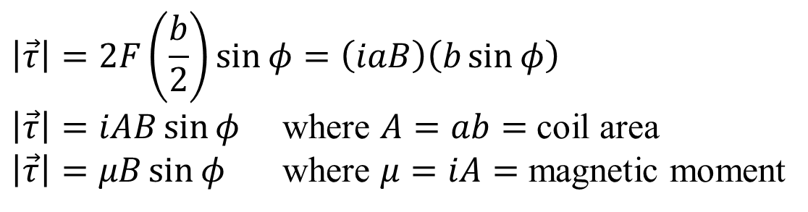
Torque on a current loop – vector approach
$\vec{F}$ and $−\vec{F}$ lie along different lines and give rise to a torque which points in the positive y direction.
By definition, torque is $\vec{τ}=\vec{r}×\vec{F}$
Hence $\vec{τ}=\vec{μ}×\vec{B}$
$$\left|\vec{τ}\right|=2F\left(\frac{b}{2}\right)\sin{φ}=\left(iaB\right)\left(b\sin{φ}\right)$$
$\left|\vec{τ}\right|=iAB\sin{φ}$ where $A=ab=$ coil area
$\left|\vec{τ}\right|=μB\sin{φ}$ where $μ=iA=$ magnetic moment

Slide 36
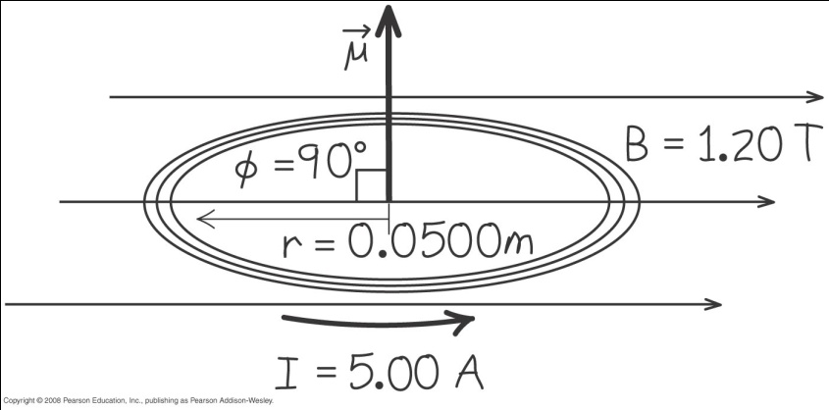
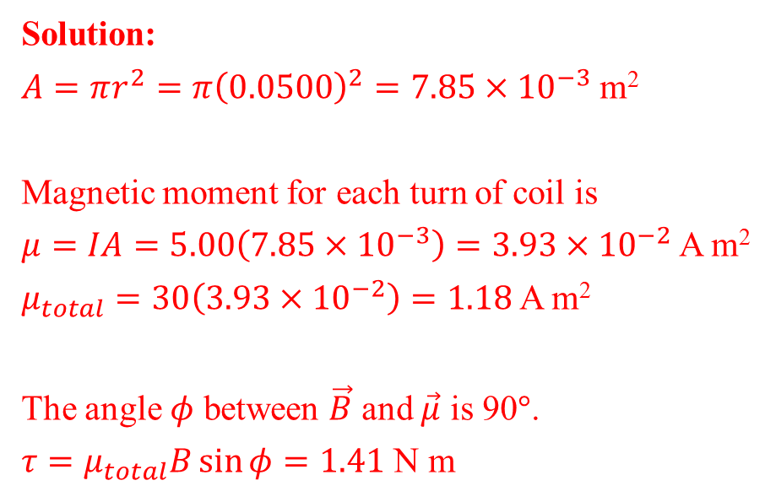
Example 9
A circular coil 0.0500 m in radius, with 30 turns of wire, lies in a horizontal plane. It carries a current of 5.00 A in a counter-clockwise sense when viewed from above. The coil is in a uniform field directed towards the right, with magnitude 1.20 T. Find the magnitudes of the magnetic moment and the torque on the coil.
Solution:
$A=πr^{2}=π{\left(0.0500\right)}^{2}=7.85×{10}^{−3}$ m²
Magnetic moment for each turn of coil is
$μ=IA=5.00\left(7.85×{10}^{−3}\right)=3.93×{10}^{−2}$ A m²
$μ_{total}=30\left(3.93×{10}^{−2}\right)=1.18$ A m²
The angle $φ$ between $\vec{B}$ and $\vec{μ}$ is 90$°$.
$τ=μ_{total}B\sin{φ}=1.41$ N m

Slide 37
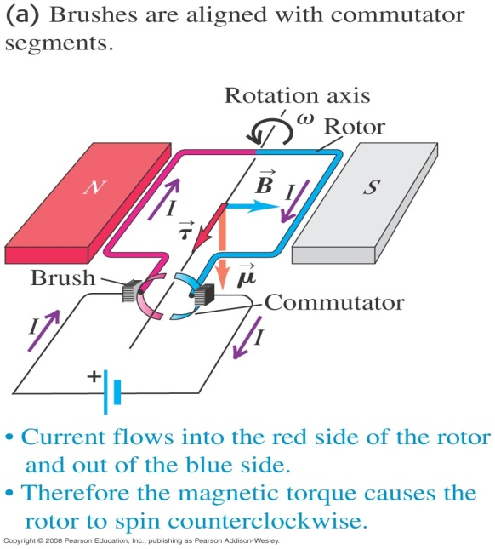
The Direct-Current motor
The rotor is an open-ended loop of wire and free to rotate about an axis.
The ends of the wire are attached to elements that form a commutator.
Each commutator segment makes contact with one of the brushes of an external circuit that includes a source of emf.
Hence the rotor is a current loop with a magnetic moment.
The magnetic field exerts a torque on the rotor and causes the rotor to rotate counter clockwise so that B is aligned with µ.

Slide 38
The Direct-Current motor
When B is aligned with µ, there is no potential difference between the segments of the commutator.
At this instant no current flows through the rotor and the magnetic moment is zero.
The rotor continues to rotate counter clockwise because of its inertia until current flows again through the rotor.
Notes:
The figure shows the rotor rotated by 90º.

Slide 39
The Direct-Current motor
The rotor has now rotated 180º and µ is in the same direction with respect to B. The torque is in the same direction as before.
Due to the commutator, the current reverses after every 180º of rotation so the torque is always in the direction to rotate the rotor counter clockwise.

Slide 40
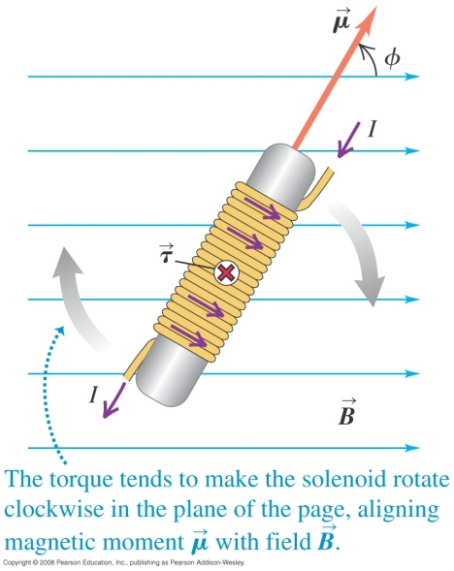
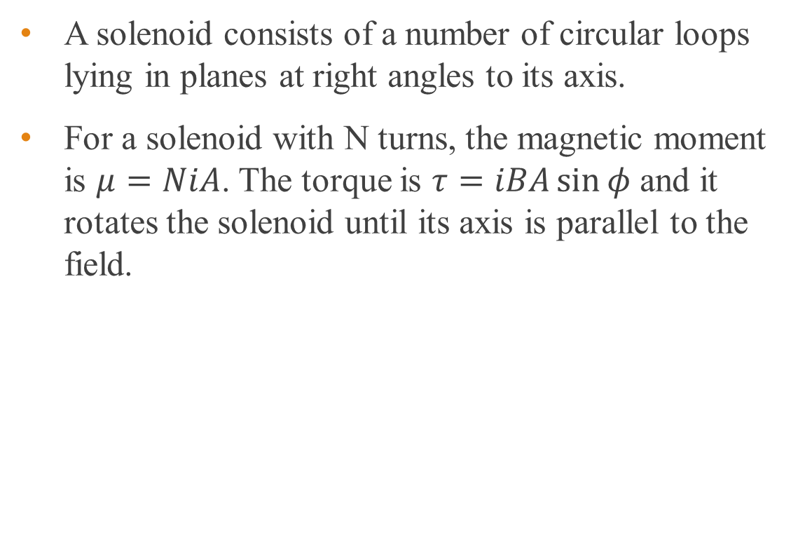
Solenoid
A solenoid consists of a number of circular loops lying in planes at right angles to its axis.
For a solenoid with N turns, the magnetic moment is $μ=NiA$. The torque is $τ=iBA\sin{φ}$ and it rotates the solenoid until its axis is parallel to the field.

Slide 41
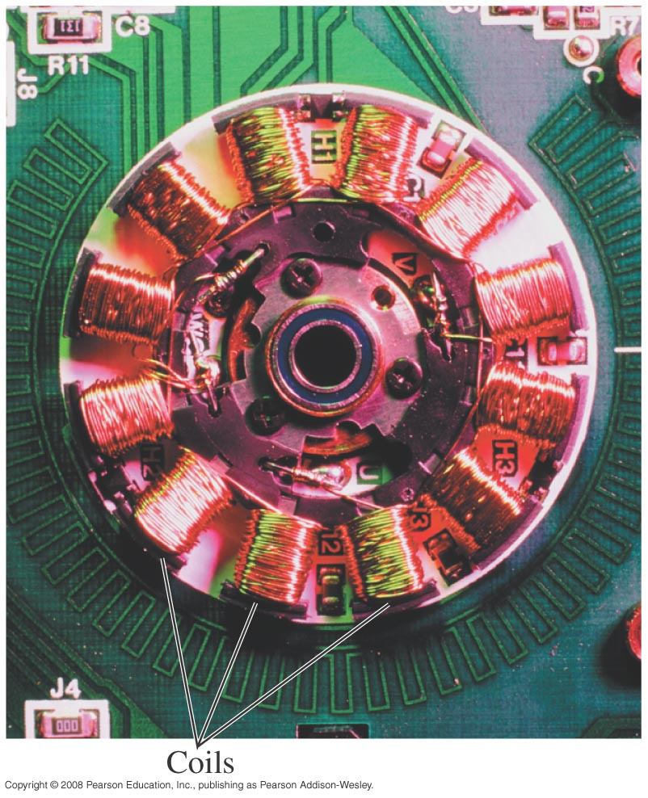
Practical motors
In practical motors, the rotor has many turns.
This increases the magnetic moment and the torque so that the motor can spin larger loads.
The torque can also be increased by using a stronger magnetic field.
Therefore many motors use electromagnets.

Slide 42
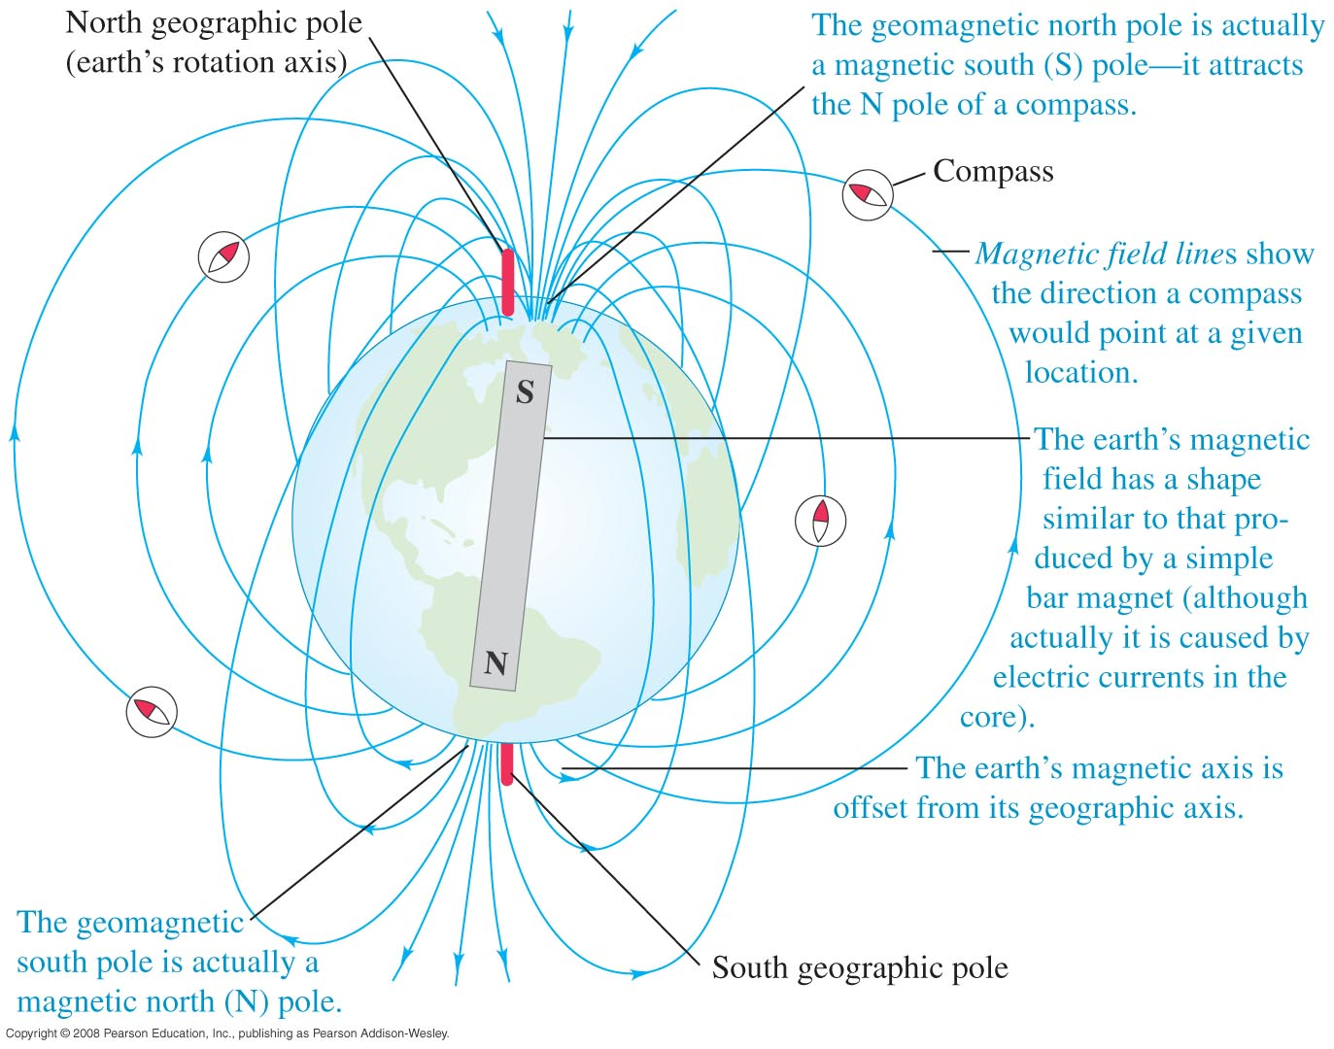
The Earth as a magnet
The Earth is like a magnet with its S pole in the geomagnetic north of the Earth and its N pole in the geomagnetic south of the Earth.
The Earth magnetic axis is not aligned with its geographic axis. Hence its geomagnetic poles are not at the same place as its geographic poles.
This leads to magnetic compass errors known as magnetic variation.

Slide 43
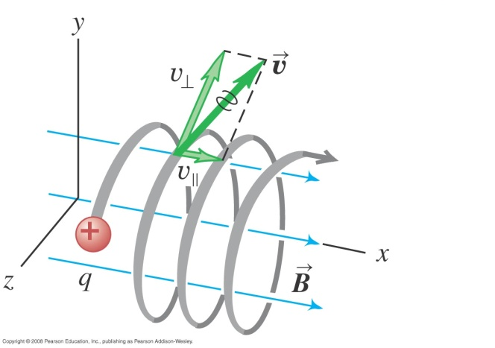

Charge particle not perpendicular to magnetic field
If the particle’s initial velocity is not perpendicular to the field, it will move in a helix with the radius we derived earlier.
If the field is not uniform, the particles will move to and fro within the field.

Slide 44
End of chapter

